Slide 1
Using AI Tools to Accelerate
(not Automate)
Video Creation
Christopher Sears
Maysville Community and Technical College
KYMATYC 2024

Slide 2
Overview
Problem Statement
Main AI Tool
Two Use Cases
Comparison Between Methods

Slide 3
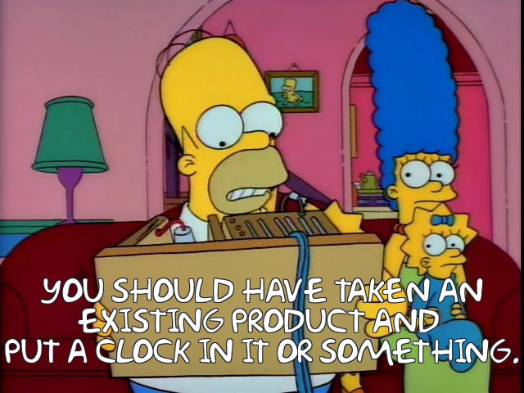
More than a Solution Looking for a Problem
Brother, Can You Spare Two Dimes?

Slide 4
Problem Statement
Want to caption videos to meet KES standards
YouTube auto-captions are OK, can edit to be better
YouTube is changing into a version of TikTok:
  Advertising important focus
  Algorithm steering people toward toxic content
Want to move to an algorithm free video sharing platform
Lose auto-caption capability

Slide 5
Problem Statement (Part 2)
Started teaching online course at East Kentucky Correctional Complex (EKCC)
Students unable to access remote sites, including YouTube and MyLab Math
Use Lantern LMS instead of Blackboard
Storage space limited to 1GB for entire course
Still need captions when Lantern LMS doesn’t have that capability

Slide 6
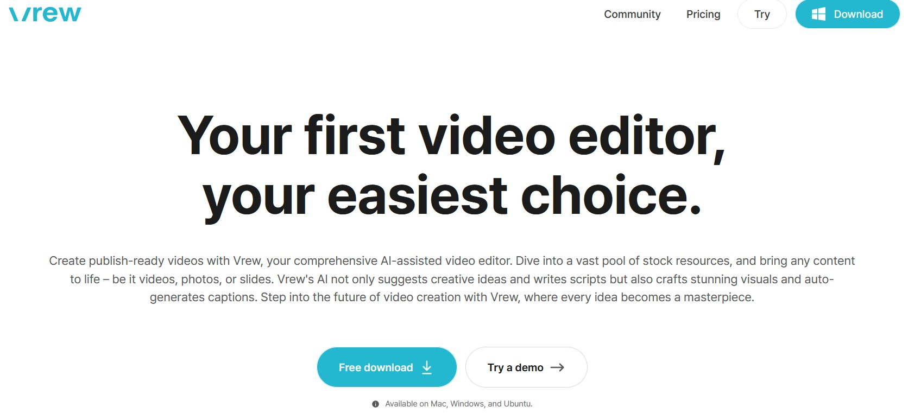
Vrew to the Rescue
Found Vrew right before KYMATYC 2023
Searching for auto-caption software
Found more uses for it later
Under rapid development
Based in Korea, but moving into US

Slide 7
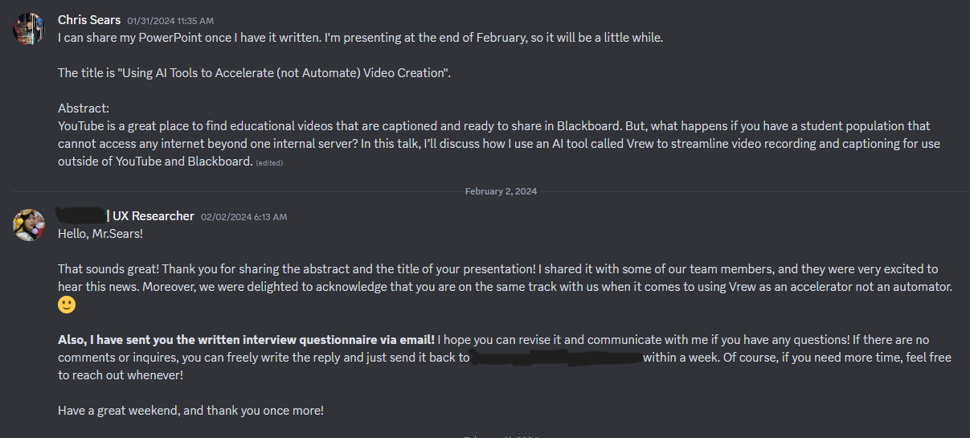
Disclosure
I helped the Vrew team answer a questionnaire about how I use the product
I am not sponsored by Vrew
I declined their generous offer of compensation for my help with the questionnaire

Slide 8
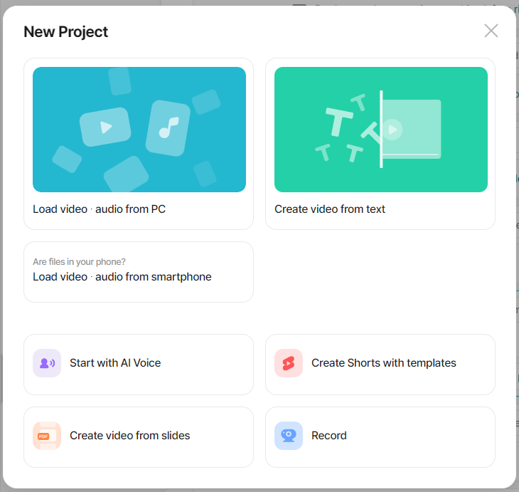
My Two Use Cases
Started by creating my videos normally and importing to Vrew for captioning and cleanup
Also use to create video from PDF document using AI generated voice
Both methods create correctly captioned videos

Slide 9
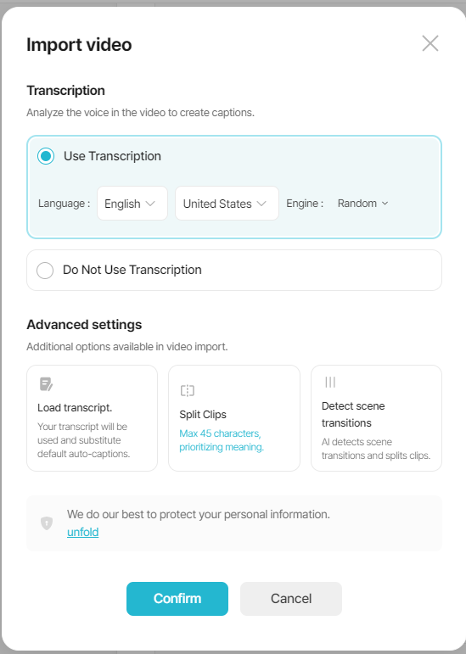
Traditional Video Creations
Create slide in LibreOffice
Record audio in Audacity
Write work by hand and scan with desktop scanner
Match audio, slides, and work in Shotcut
Caption video in Vrew
Export from Vrew

Slide 10
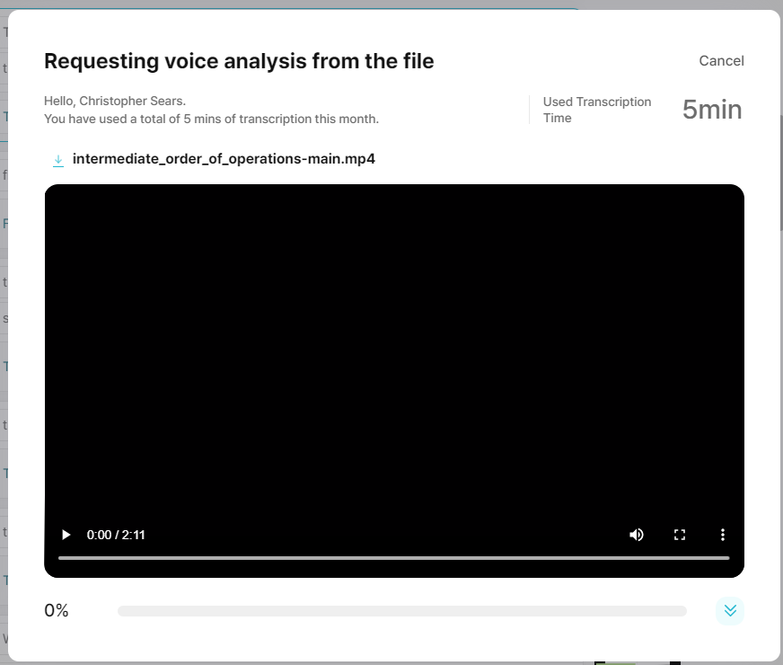
Auto-Captioning
Vrew detects speech and creates captions
Free account limited to 120 minutes each month
AI great for regular speech
Not so great for math

Slide 11
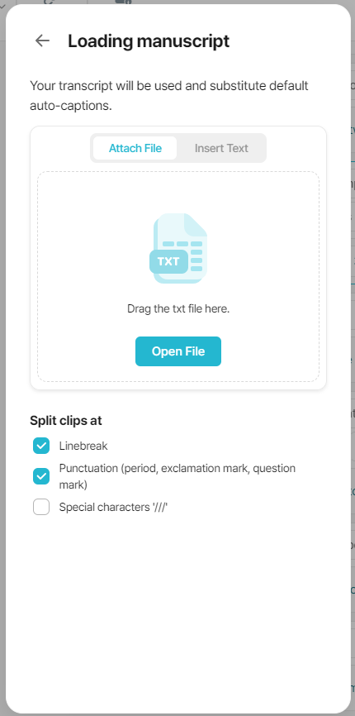
Improving Speech Recognition
Can add manuscript as text file too
Writing a script cuts down on video length and size
Still struggles to match text to math terms
Easy to edit

Slide 12
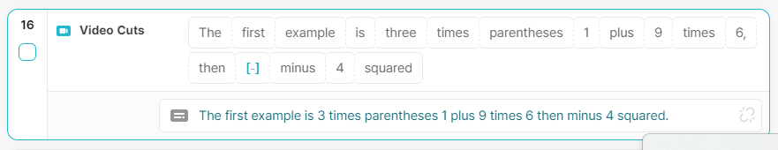
Editing Captions
The UI breaks the text into boxes
Each box represents a piece of the video
Can delete pieces of the video by deleting the boxes
Great for removing breaths and mouth noise
Can edit captions in the text box below

Slide 13
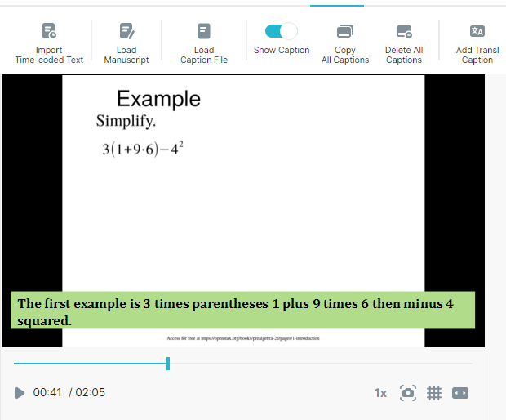
Captions
Captions are displayed in the video
Captions can be removed from the video
You can format the captions to taste

Slide 14
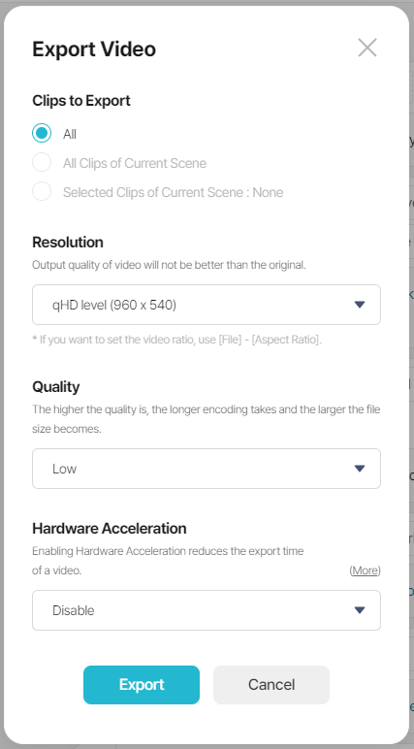
Export for Lantern
Students use tablets to access course materials
Video resolution limited to 480p or so
Export with captions on
Lowest quality settings
Find hardware acceleration increases file size

Slide 15
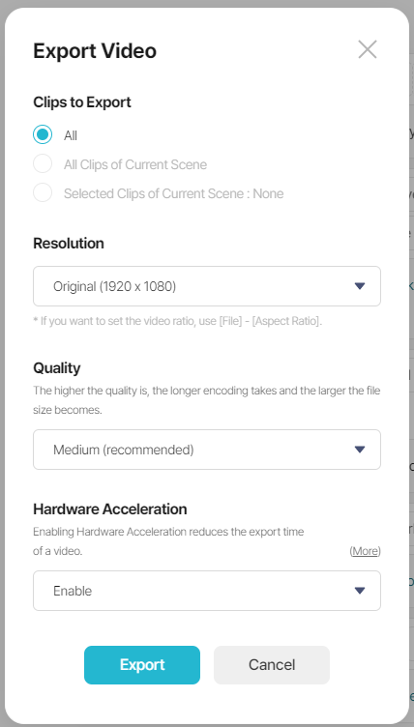
Export for PeerTube
Embed PeerTube into Blackboard
Higher resolution is good
Export with captions turned off
Export captions in separate SubRip file
SupRip file can be imported into PeerTube or YouTube

Slide 16
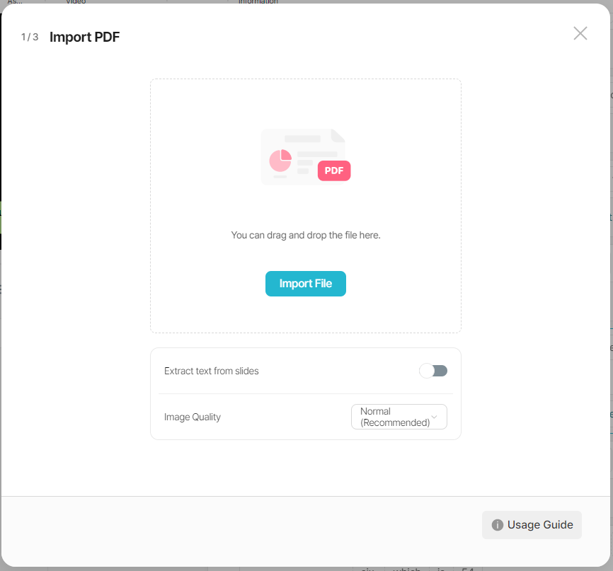
Create Video from Slide
Slides have to be in PDF format
Can export from PowerPoint, LiberOffice Impress, or LaTeX Beamer
Still do work on paper with scans

Slide 17
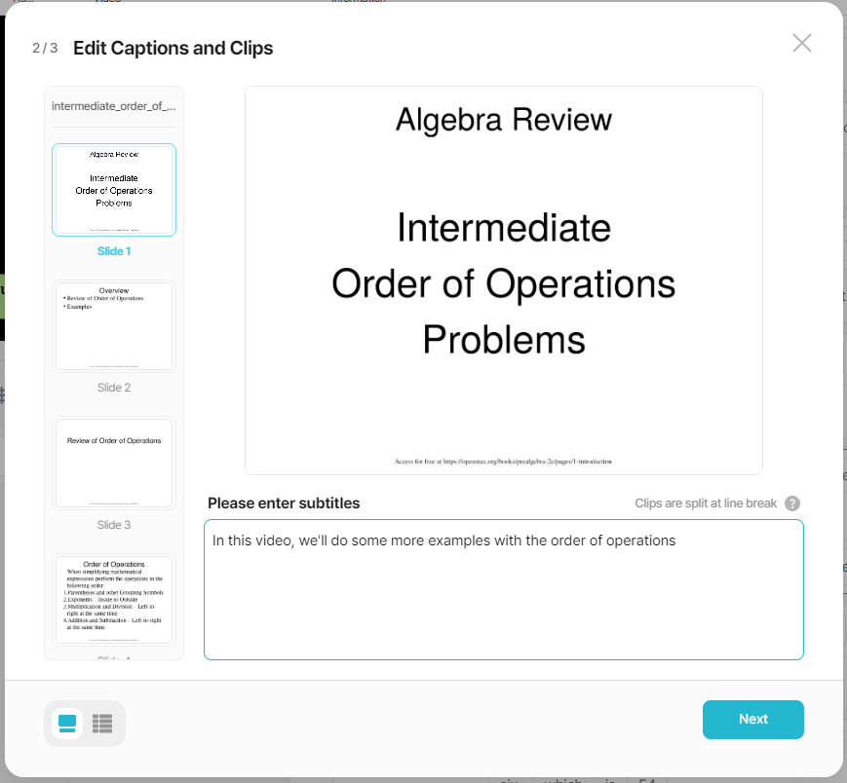
Writing Captions
Write captions for each slide
Each line becomes it’s own caption
Can spell check and edit captions in next step

Slide 18
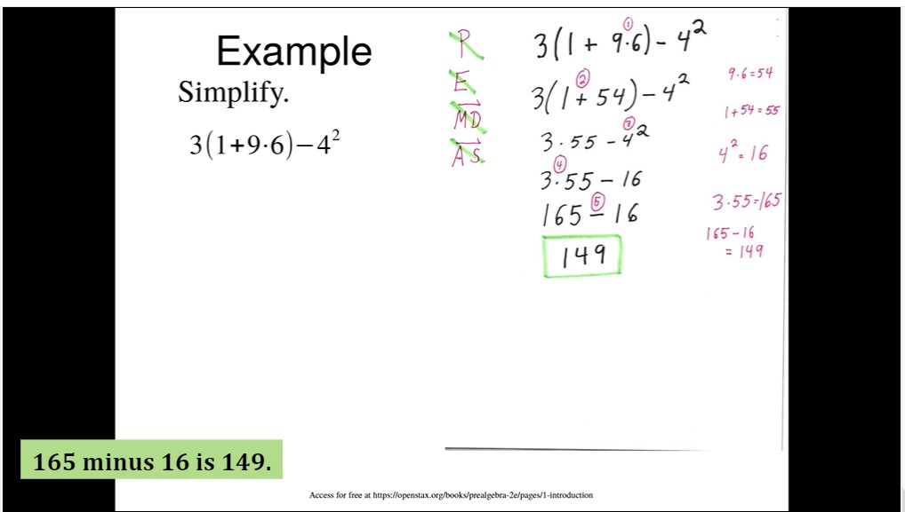
Finishing
Overlay math work on top of slides
Simple drag-and-drop
Export as before

Slide 19
Comparison of Methods
Traditional Video
  Background – 8:39
  Work – 12:34
  Script – 9:45
  Audio – 9:16
  Video – 12:43
  Caption – 6:09 (cut 6 seconds of breaths)
  Export – 1:02
  Total – 61:35
11 scans, 7 slides, 314 word script, 2:05 length
AI Voice
  Background – 10:20
  Work – 19:20
  Script – 12:33
  Edit – 16:40
  Export – 1:51
  Total – 60:44
18 scans, 7 slides, 332 word script, 2:26 length

Slide 20
Final Thoughts
Like Vrew for both video editing and captioning
AI Generated voice speeds the process
Adding personal character to video worth the extra time
Can find more efficiencies in process

Slide 21
This work is licensed under a Creative Commons Attribution-ShareAlike 3.0 Unported License.
It makes use of the works of Mateus Machado Luna.
Where to find me:
Mastodon: https://qoto.org/@OmegaLimit
PeerTube: https://spectra.video/c/chris_sears_teaching/videos
Website: https://prof-sears.github.io
GitHub: https://github.com/Prof-Sears/Vrew-projects

